Slide 1

React Fundamentals
Aj.Amonpan Chomklin
Information Technology 1/2563
Ref:https://reactnative.dev/docs/intro-react
Notes:
NOTE:
To change the image on this slide, select the picture and delete it. Then click the Pictures icon in the placeholder to insert your own image.

Slide 2
React Fundamentals
React Native runs on React, a popular open source library for building user interfaces with JavaScript. To make the most of React Native, it helps to understand React itself. This section can get you started or can serve as a refresher course.
We’re going to cover the core concepts behind React:
components
JSX
props
state

Slide 3
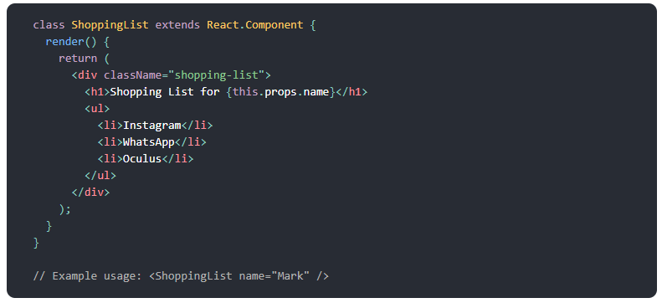
Overview
What Is React?
React is a declarative, efficient, and flexible JavaScript library for building user interfaces. It lets you compose complex UIs from small and isolated pieces of code called “components”.
React has a few different kinds of components, but we’ll start with React.Component subclasses:

Slide 4
Your first component
The rest of this introduction to React uses cats in its examples: friendly, approachable creatures that need names and a cafe to work in. Here is your very first Cat component:
import React, { Component } from 'react';
import { Text } from 'react-native';
export default class Cat extends Component {
render() {
return (
<Text>Hello, I am your cat!</Text>
);
}
}

Slide 5


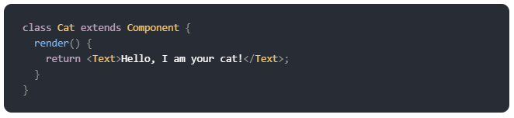
Your first component
You additionally import Component from React:
Your component starts as a class extending Component instead of as a function:
Class components have a render() function. Whatever is returned inside it is rendered as a React element:

Slide 6
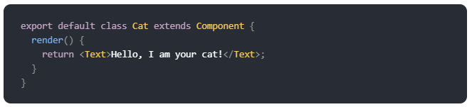

Your first component
And as with function components, you can export your class component:
Now take a closer look at that return statement. <Text>Hello, I am your cat!</Text> is using a kind of JavaScript syntax that makes writing elements convenient: JSX.
Output:

Slide 7
Core Components and Native Components
React Native is an open source framework for building Android and iOS applications using React and the app platform’s native capabilities.
With React Native, you use JavaScript to access your platform’s APIs as well as to describe the appearance and behavior of your UI using React components: bundles of reusable, nestable code.
You can learn more about React in the next section. But first, let’s cover how components work in React Native

Slide 8
Views and mobile development
In Android and iOS development, a view is the basic building block of UI: a small rectangular element on the screen which can be used to display text, images, or respond to user input.
Even the smallest visual elements of an app, like a line of text or a button, are kinds of views. Some kinds of views can contain other views.
It’s views all the way down!

Slide 9
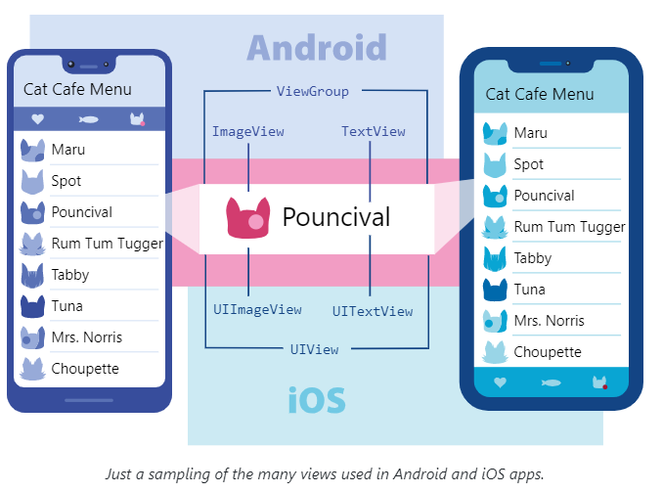

Slide 10
Native Components
With React Native, you can invoke these views with JavaScript using React components. At runtime, React Native creates the corresponding Android and iOS views for those components. Because React Native components are backed by the same views as Android and iOS, React Native apps look, feel, and perform like any other apps. We call these platform-backed components Native Components.
React Native lets you to build your own Native Components for Android and iOS to suit your app’s unique needs. We also have a thriving ecosystem of these community-contributed components. Check out React Native Directory to find what the community has been creating.
React Native also includes a set of essential, ready-to-use Native Components you can use to start building your app today. These are React Native's Core Components.

Slide 11
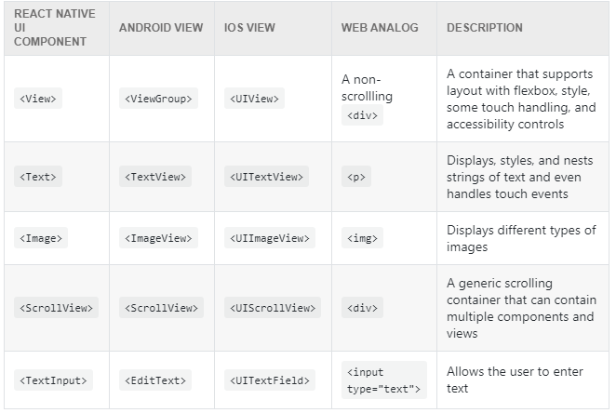
Core Components
React Native has many Core Components for everything from form controls to activity indicators. You can find them all documented in the API section. You will mostly work with the following Core Components:

Slide 12
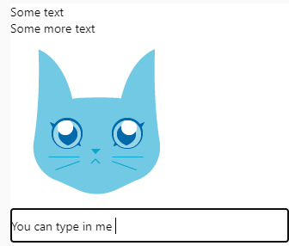
import React from 'react';
import { View, Text, Image, ScrollView, TextInput } from 'react-native';
export default function App() {
return (
<ScrollView>
<Text>Some text</Text>
<View>
<Text>Some more text</Text>
<Image source={{uri: "https://reactnative.dev/docs/assets/p_cat2.png"}} style={{width: 200, height: 200}}/>
</View>
<TextInput
style={{
height: 40,
borderColor: 'gray',
borderWidth: 1
}}
defaultValue="You can type in me"
/>
</ScrollView>
);
}

Slide 13
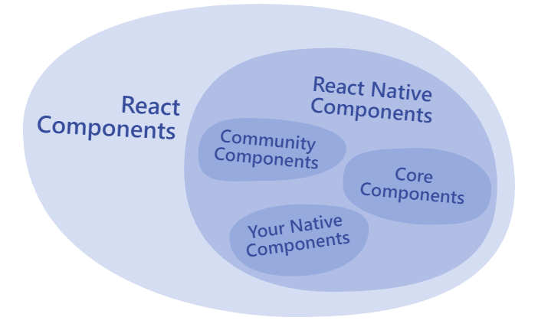
Core Components
Because React Native uses the same API structure as React components, you’ll need to understand React component APIs to get started.

Slide 14
Custom Components
You’ve already met React Native’s Core Components. React lets you nest these components inside each other to create new components. These nestable, reusable components are at the heart of the React paradigm.
For example, you can nest Text and TextInput inside a View below, and React Native will render them together:

Slide 15

import React from 'react';
import { Text, TextInput, View } from 'react-native';
export default function Cat() {
return (
<View>
<Text>Hello, I am...</Text>
<TextInput
style={{
height: 40,
borderColor: 'gray',
borderWidth: 1
}}
defaultValue="Name me!"
/>
</View>
);
}

Slide 16

import React from 'react';
import { Text, TextInput, View } from 'react-native';
function Cat() {
return (
<View>
<Text>I am a also cat!</Text>
</View>
);
}
export default function Cafe() {
return (
<View>
<Text>Welcome!</Text>
<Cat />
<Cat />
<Cat />
</View>
);
}

Slide 17
Custom Components
Any component that renders other components is a parent component. Here, Cafe is the parent component and each Cat is a child component.
You can put as many cats in your cafe as you like. Each <Cat> renders a unique element—which you can customize with props.

Slide 18
React Fundamentals
React Native runs on React, a popular open source library for building user interfaces with JavaScript. To make the most of React Native, it helps to understand React itself. This section can get you started or can serve as a refresher course.
We’re going to cover the core concepts behind React:
components
JSX
props
state

Slide 19
JSX
React and React Native use JSX, a syntax that lets you write elements inside JavaScript like so: <Text>Hello, I am your cat!</Text>.
Here you are declaring a name for the cat, name, and embedding it with curly braces inside <Text>.
import React from 'react';
import { Text } from 'react-native';
export default function Cat() {
const name = "Maru";
return (
<Text>Hello, I am {name}!</Text>
);
}
JSX is included in the React library, it won’t work if you don’t have import React from 'react' at the top of your file!

Slide 20
What is JSX
JSX ย่อมาจาก ( JavaScript Syntax eXtension) ซึ่งหมายถึงส่วนเสริมของ Javascript ถูกพัฒนาขึ้นมาใช้กับ React โดยเฉพาะ โดย Syntax นั้นมีความคล้ายคลึงกับ HTML เป็นอย่างมาก
รูปแบบของ JSX นั้นเหมือนกับ HTML เป็นอย่างมาก แต่ที่เห็นได้ชัดคือจะเห็นการเขียนโค้ดในลักษณะนี้ในอยู่ในไฟล์ Javascript แทนที่จะเป็นไฟล์ HTML

Slide 21

JSX Elements
JSX นั้นถือว่าเป็น JavaScript Expression กล่าวคือทุกๆที่ ที่สามารถเขียน Expression ได้ ก็สามารถเขียน JSX ได้เช่นกัน หมายความว่า เราสามารถบันทึก JSX element ไว้ในตัวแปรต่างๆ,ส่งผ่านไปยังฟังก์ชัน,เก็บไว้ในออบเจกต์ หรืออาร์เรย์ได้ เพียงแค่เรากำหนดตัวแปรให้กับมัน
ตัวอย่างการเก็บ JSX element ไว้ในตัวแปร

Slide 22
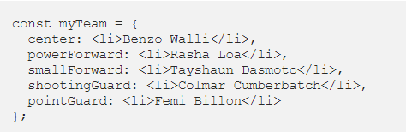
JSX Elements
ตัวอย่างการเก็บ JSX elements ไว้ในออบเจกต์

Slide 23

Attributes In JSX
ใน JSX เองสามารถมี Attribute ได้เหมือนกับ HTML อีกทั้งยังมีความคล้ายคลึงกันมาก โดยการประกาศ Attribute สามารถทำได้ดังนี้
ตัวอย่างการใช้งาน JSX elements ร่วมกับ Attributes
ในหนึ่ง Element สามารถมีได้หลาย Attributes เหมือนกันกับ HTML

Slide 24
แบบฝึกหัด
ประกาศค่าคงที่ (const) ชื่อ p1 ขึ้นมาสำหรับเก็บ JSX element <p></p> และมีข้อความข้างในคือ foo
ในบรรทัดต่อมาให้ประกาศค่าคงที่เช่นเดิม แต่เปลี่ยนชื่อเป็น p2 และมีข้อความข้างในเป็น bar
และเพิ่ม Attributes id ขึ้นมาโดยกำหนดให้ p1 มี id=”learge” และ p2 มี id=”small ”

Slide 25

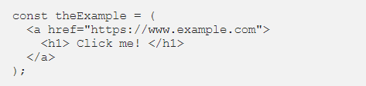
Nested JSX
เราสามารถเขียน JSX element ซ้อนๆกันได้เหมือนใน HTML ดังตัวอย่างต่อไปนี้
ซึ่งถ้า JSX expression มีมากกว่าหนึ่งบรรทัด จำเป็นต้องใส่วงเล็บ () ครอบไว้ด้วย ดังตัวอย่าง

Slide 26
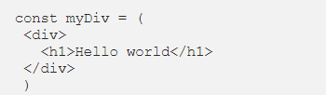
แบบฝึกหัด
ให้ประกาศตัวแปร myDiv ขึ้นมาและกำหนดให้ตัวแปรเก็บค่า JSX element <div></div> ไว้
โดยใน tag <div> มี tag <h1></h1> ซ้อนอยู่ข้างใน และให้ tag <h1> มีข้อความ Hello world

Slide 27
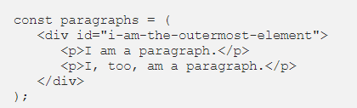

JSX Outer Elements
ในรูปแบบการเขียน JSX นั้นมีอีกกฏนึงที่ยังไม่ได้พูดถึง ให้ลองสังเกตุความแตกต่างของโค้ดทั้งสองอันนี้
ตัวอย่างโค้ดที่สามารถทำงานได้
ตัวอย่างโค้ดที่ไม่สามารถทำงานได้
ถ้าสังเกตุดีๆจะเห็นว่าโค้ดข้างล่างนี้ไม่มี tag<div></div> ครอบอยู่ เหตุที่ต้องมีเพราะว่า JSX นั้นยอมให้มี root element ได้เพียงอันเดียวเท่านั้น ถ้ามี elements สองอัน จะอยู่แยกกันไม่ได้ วิธีที่ง่ายที่สุดในการแก้ปัญหา คือครอบด้วย tag <div></div> นั่นเอง

Slide 28
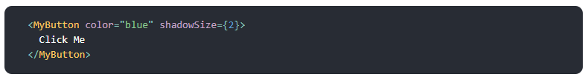
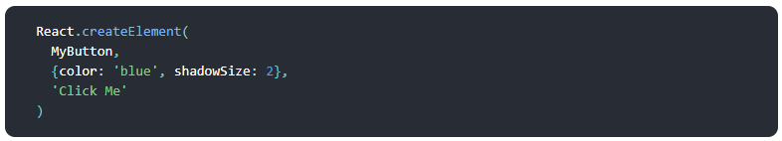
JSX In Depth
Fundamentally, JSX just provides syntactic sugar for the
React.createElement(component, props, ...children)
function. The JSX code:
compiles into:

Slide 29
JSX
Any JavaScript expression will work between curly braces, including function calls like {getFullName("Rum", Tum", "Tugger")}:
import React from 'react';
import { Text } from 'react-native';
export default function Cat() {
function getFullName(firstName, secondName, thirdName) {
return firstName + " " + secondName + " " + thirdName;
}
return (
<Text>
Hello, I am { getFullName("Rum", "Tum", "Tugger") } !
</Text>
);
}
Hello, I am Rum Tum Tugger!

Slide 30
React Fundamentals
React Native runs on React, a popular open source library for building user interfaces with JavaScript. To make the most of React Native, it helps to understand React itself. This section can get you started or can serve as a refresher course.
We’re going to cover the core concepts behind React:
components
JSX
props
state

Slide 31
Props
Props is short for “properties.” Props let you customize React components. For example, here you pass each <Cat> a different name for Cat to render:

Slide 32

import React from 'react';
import { Text, View } from 'react-native';
function Cat(props) {
return (
<View>
<Text>Hello, I am {props.name}!</Text>
</View>
);
}
export default function Cafe() {
return (
<View>
<Cat name="Maru" />
<Cat name="Jellylorum" />
<Cat name="Spot" />
</View>
);
}

Slide 33
Props
Most of React Native’s Core Components can be customized with props, too. For example, when using Image, you pass it a prop named source to define what image it shows:

Slide 34
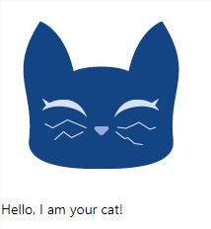
import React from 'react';
import { Text, View, Image } from 'react-native';
export default function CatApp() {
return (
<View>
<Image
source={{uri: "https://reactnative.dev/docs/assets/p_cat1.png"}}
style={{width: 200, height: 200}}
/>
<Text>Hello, I am your cat!</Text>
</View>
);
}
Image has many different props, including style, which accepts a JS object of design and layout related property-value pairs.

Slide 35
React Fundamentals
React Native runs on React, a popular open source library for building user interfaces with JavaScript. To make the most of React Native, it helps to understand React itself. This section can get you started or can serve as a refresher course.
We’re going to cover the core concepts behind React:
components
JSX
props
state

Slide 36
State
While you can think of props as arguments you use to configure how components render, state is like a component’s personal data storage.
State is useful for handling data that changes over time or that comes from user interaction.
State gives your components memory!
As a general rule, use props to configure a component when it renders. Use state to keep track of any component data that you expect to change over time.

Slide 37
State
The following example takes place in a cat cafe where two hungry cats are waiting to be fed.
Their hunger, which we expect to change over time (unlike their names), is stored as state.
To feed the cats, press their buttons—which will update their state.
The older class components approach is a little different when it comes to state.

Slide 38
import React, { Component } from "react";
import { Button, Text, View } from "react-native";
export class Cat extends Component {
state = { isHungry: true };
render(props) {
return (
<View>
<Text>
I am {this.props.name}, and I am
{this.state.isHungry ? " hungry" : " full"}!
</Text>
<Button
onPress={() => {
this.setState({ isHungry: false });
}}
disabled={!this.state.isHungry}
title={
this.state.isHungry ? "Pour me some milk, please!" : "Thank you!"
}
/>
</View>
);
}
}
export default class Cafe extends Component {
render() {
return (
<>
<Cat name="Munkustrap" />
<Cat name="Spot" />
</>
);
}
}

Slide 39

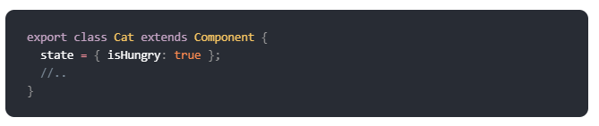
State
As always with class components, you must import the Component class from React:
In class components, state is stored in a state object:

Slide 40
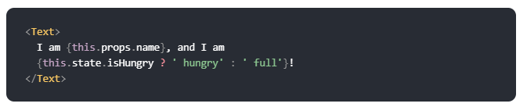
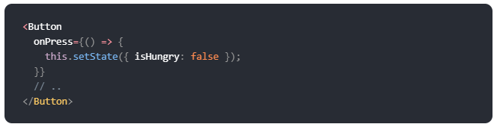
State
As with accessing props with this.props, you access this object inside your component with this.state:
And you set individual values inside the state object by passing an object with the key value pair for state and its new value to this.setState():

Slide 41
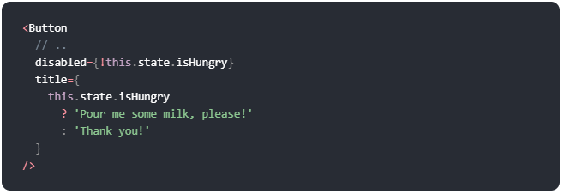
State
Do not change your component's state directly by assigning it a new value with this.state.hunger = false. Calling this.setState() allows React to track changes made to state that trigger rerendering. Setting state directly can break your app's reactivity!
When this.state.isHungry is false, the Button’s disabled prop is set to false and its title also changes:

Slide 42
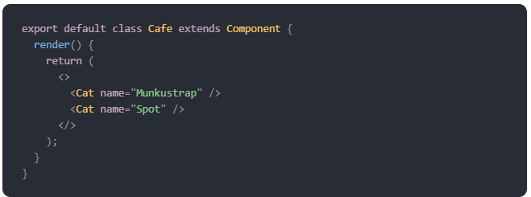
State
Finally, put your cats inside a Cafe component:
See the <> and </> above? These bits of JSX are fragments. Adjacent JSX elements must be wrapped in an enclosing tag. Fragments let you do that without nesting an extra, unnecessary wrapping element like View.

Slide 43
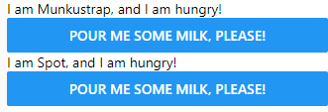
import React, { Component } from "react";
import { Button, Text, View } from "react-native";
export class Cat extends Component {
state = { isHungry: true };
render(props) {
return (
<View>
<Text>
I am {this.props.name}, and I am
{this.state.isHungry ? " hungry" : " full"}!
</Text>
<Button
onPress={() => {
this.setState({ isHungry: false });
}}
disabled={!this.state.isHungry}
title={
this.state.isHungry ? "Pour me some milk, please!" : "Thank you!"
}
/>
</View>
);
}
}
export default class Cafe extends Component {
render() {
return (
<>
<Cat name="Munkustrap" />
<Cat name="Spot" />
</>
);
}
}

